Slide 1
The Impact of Automation on Employment: Navigating the Future Workforce
Will automation ultimately lead to increase rather than decrease in job opportunities?

Slide 2

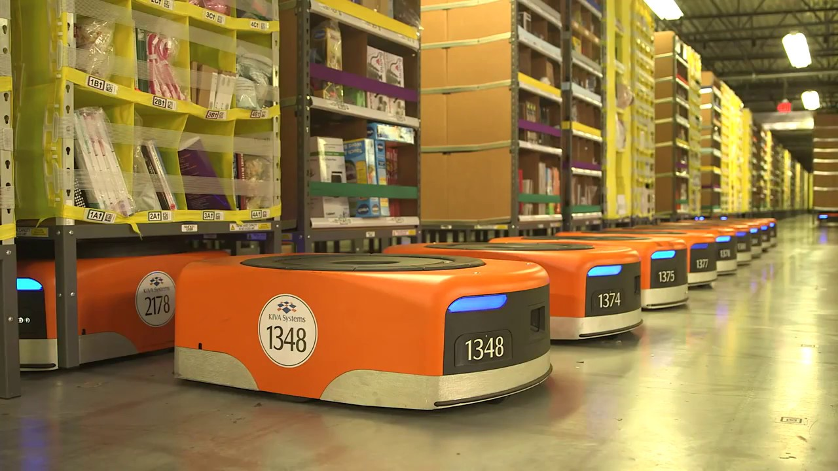
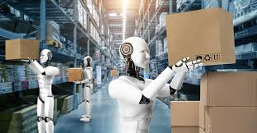

Automation and Employment
Definition of Automation
Impact on Employment
Opportunity and Challenge
is defined as the use of technology to operate without human intervention
By 2030, up to 800 million global workers could be displaced by automation
is becoming increasingly critical as countries recover from the economic effects of COVID-19 into everyday business operations
raises concerns about job loss and the widening skills gap
Technological advancements reshape the job market by displacing certain jobs
However, they also create new opportunities through innovation and economic growth

Slide 3
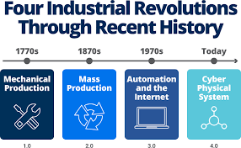
Arguments for Increased Job Opportunities
Historical Context of Automation
Industrial Revolution marked a turning point in labor markets.
In the early 20th century, the mechanization of agriculture showcased how automation could transform industries.
Role of Social Policies in Mitigating Automation Effects
After WWII, 42% of jobs in the UK were rendered redundant due to economic shifts.
The global financial crisis of 2008 and COVID-19 highlight the importance of robust social and legal policies for economic stability
Proactive government intervention can play a critical role in mitigating the adverse effects of automation

Slide 4


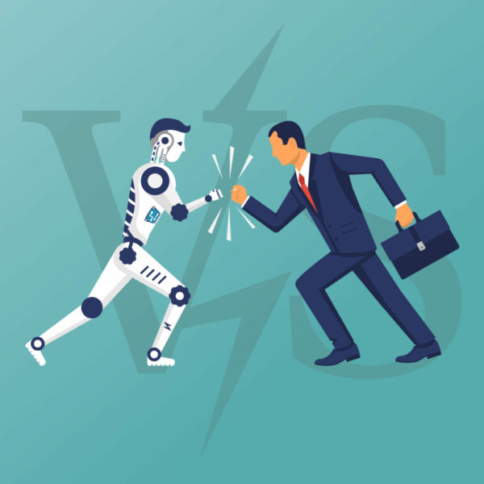


Arguments for decreased Job Opportunities
Political
Technological
Lack of government intervention
Insufficient labor protection policies
Rapid advancements in AI
Companies favor candidates with specialized technical skills
Economic
Job displacement in routine and middle-skill roles
Economic polarization
Social
Women disproportionately
Decline in social mobility

Slide 5


Personal Position on Automation and Employment
Innovation Catalyst: drives innovation and enhances competitiveness by creating new job markets.
Education & Re-skilling: presents opportunities for training displaced workers in high-demand fields.
Emergence of Hybrid Jobs: transforms traditional roles into hybrid jobs

Slide 6

Conclusion
Job Creation Potential: has the potential to create more jobs than it displaces
Social Implications: prevents automation from worsening unemployment and inequality
Education and Reskilling: invests to train displaced workers

